Slide 1
Lab 3
Firewall Implementation
& Access Control
CSIT491 - Network and Cybersecurity Lab
Anthony Castellanos • Imran Ahmed • Murtaza Syed
Nicolas Hoyos • Shaied Uddin

Slide 2
Lab Objectives
1
Configure router interfaces (FastEthernet0/0 and FastEthernet0/1) with IP addresses and bring them up
2
Apply an Extended Named ACL (FIREWALL_POLICY) to permit HTTP (80) and HTTPS (443) while denying SSH (22) and Telnet (23)
3
Test allowed traffic (HTTP browser) and blocked traffic (Telnet) from PC0 to Server0
4
Verify ACL enforcement using show access-list and Wireshark traffic captures

Slide 3
Equipment & Tools
Router
Switch
1x Cisco 2811 Router (FastEthernet Interface)
No switch — direct PC0 to Router0 connection
End Devices
Software
1x PC (PC0), 1x Server (Server-PT)
Cisco Packet Tracer 8.2.2

Slide 4
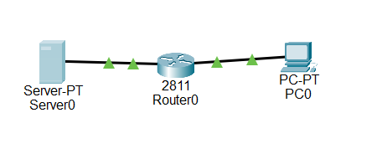
Network Topology
[ Insert Screenshot ]

Slide 5
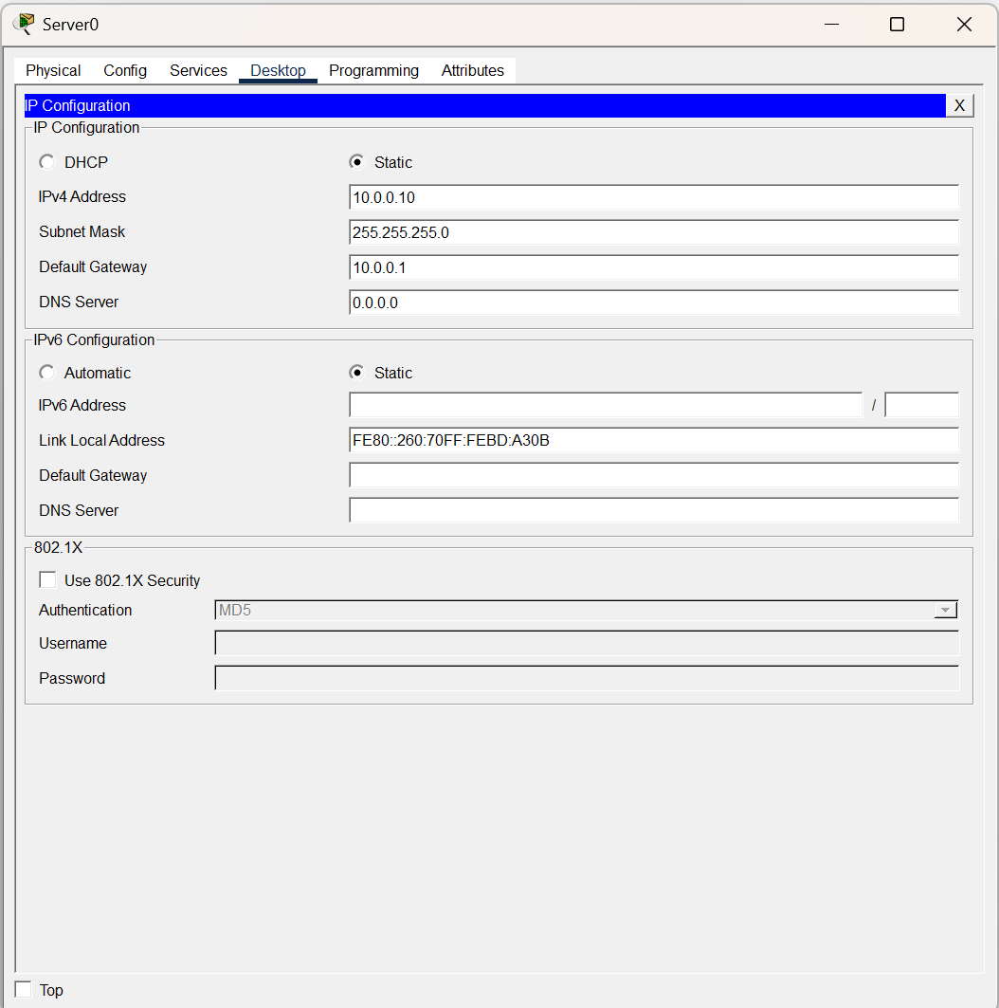
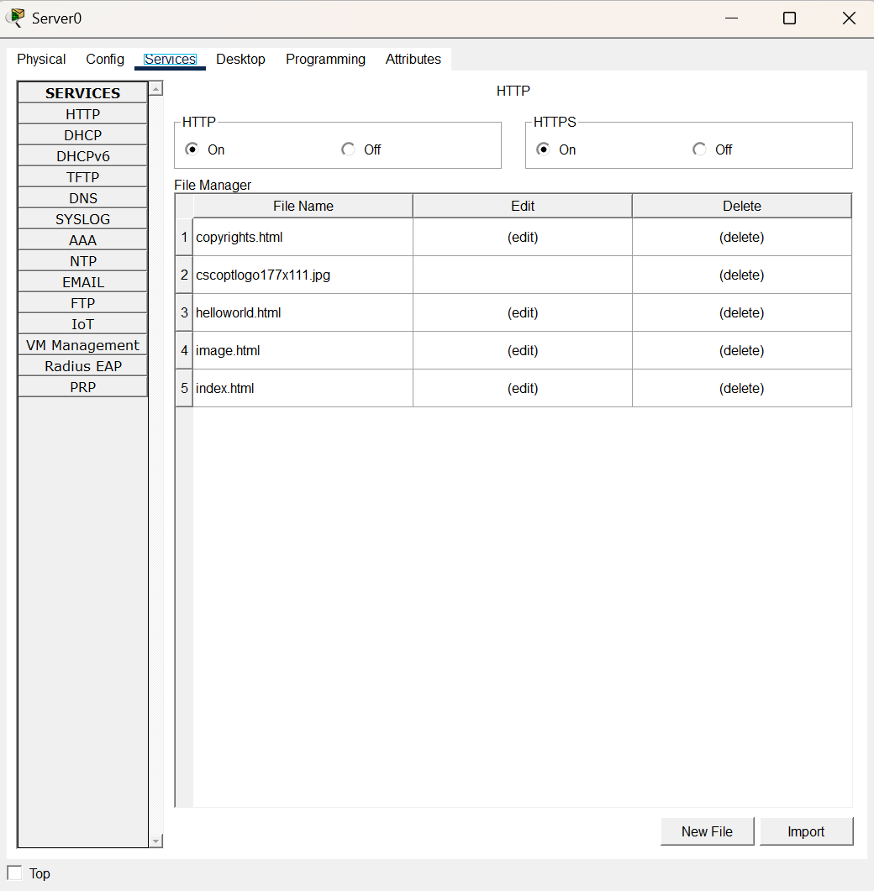
Network Setup - Server0
[ Insert Screenshot ]

Slide 6
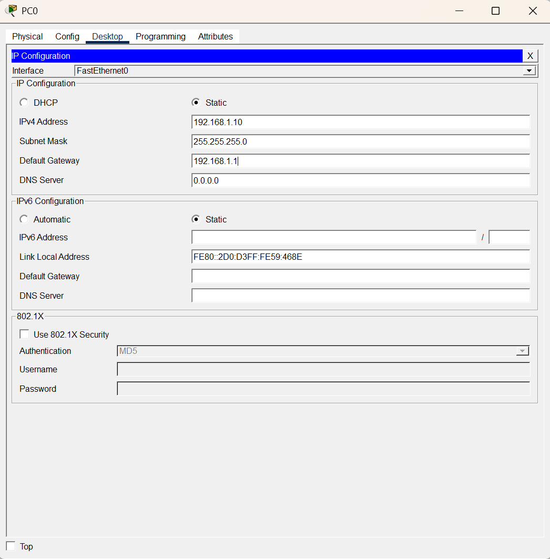
Network Setup - PC0
[ Insert Screenshot ]

Slide 7
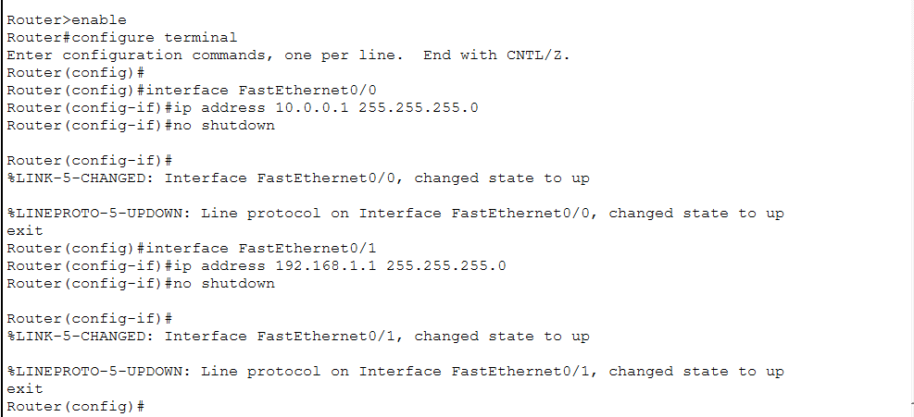
Firewall Configuration
Interface Setup
interface FastEthernet0/0
ip address 10.0.0.1
255.255.255.0
no shutdown
exit
Verify
[ Insert Screenshot ]
do show ip interface brief
Fa0/0 10.0.0.1
YES manual up up
show ip interface brief — Fa0/0 and Fa0/1 both up/up

Slide 8
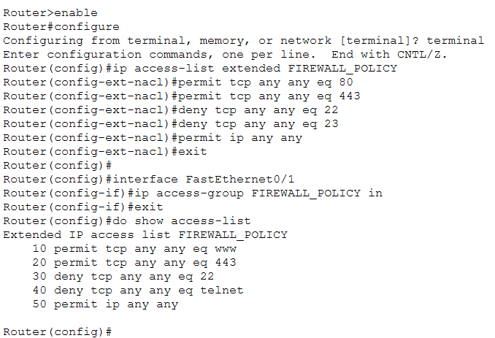
ACL Configuration
FIREWALL_POLICY Rules
ACL Rule Summary
Define and apply the ACL
ip access-list extended FIREWALL_POLICY
HTTP (80)
permit
permit tcp any any eq 80
HTTPS (443)
permit
permit tcp any any eq 443
permit ip any any
deny tcp any any eq 22
SSH (22)
deny
Telnet (23)
deny
All other IP
permit

Slide 9
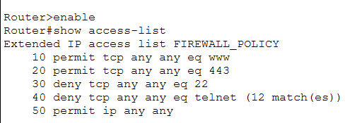
ACL rule verification
Define and apply the ACL
ip access-list extended FIREWALL_POLICY
permit tcp any any eq 80
permit tcp any any eq 443
permit ip any any
deny tcp any any eq 22

Slide 10
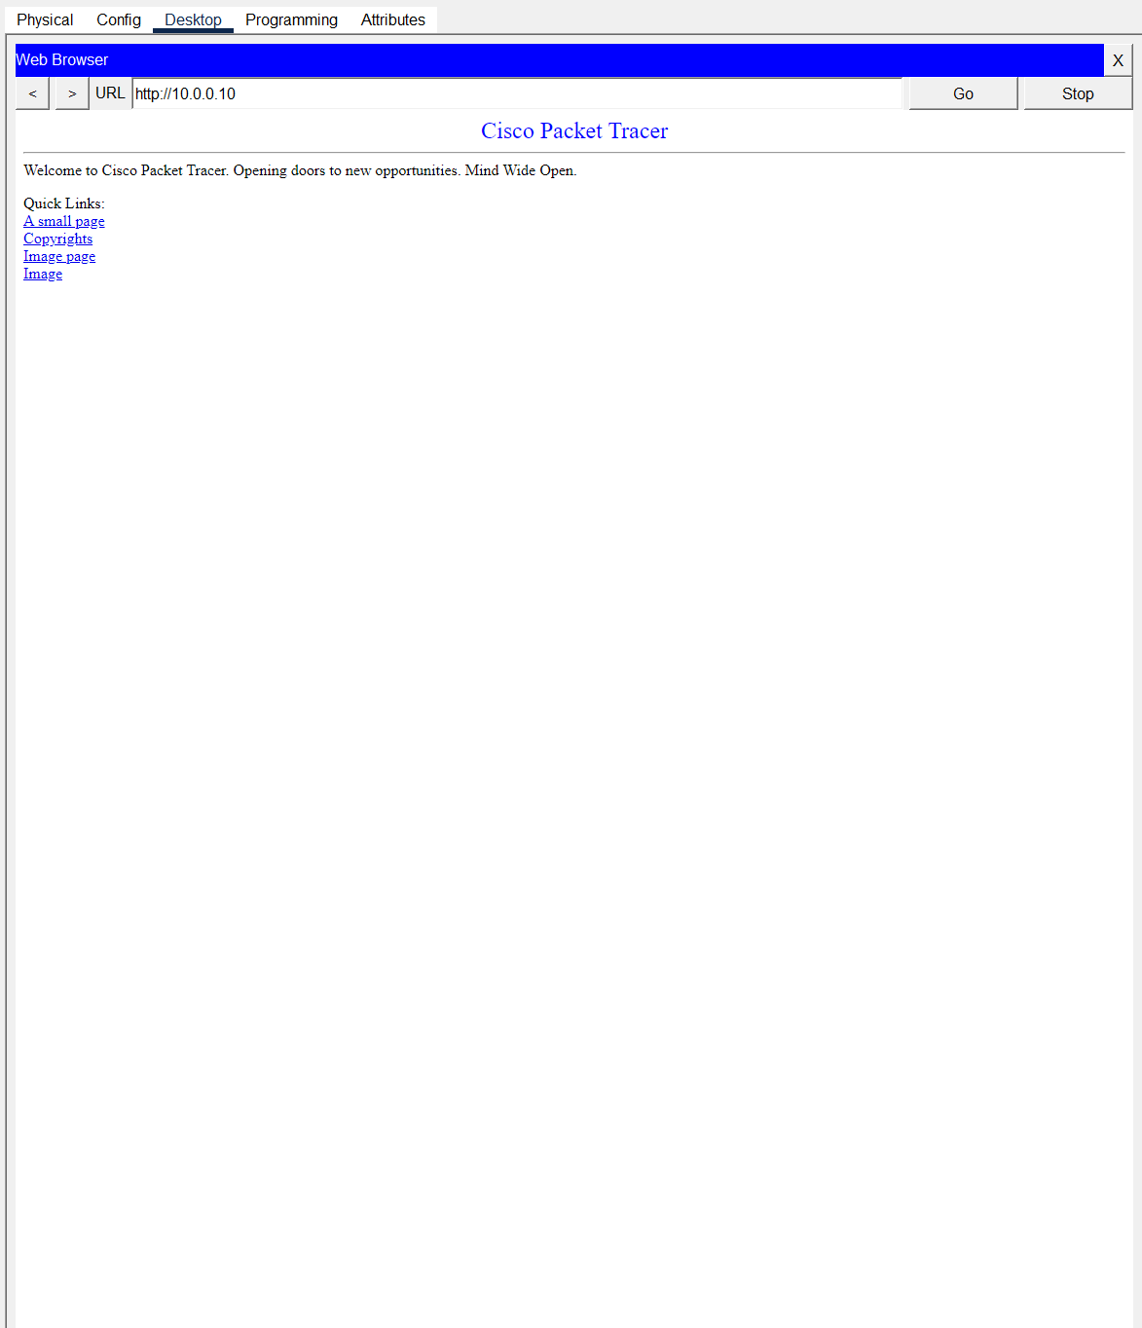
Allowed Traffic Testing
✓ HTTP Permitted
HTTP Permitted
PC0 → Server0 (HTTP)
Allowed
PC0 → Server0 (HTTPS)
Allowed
[ Insert Screenshot ]
ACL Rule — Port 443
Allowed
PC0 Web Browser — HTTP to Server0 (10.0.0.10) — Page Loaded Successfully

Slide 11
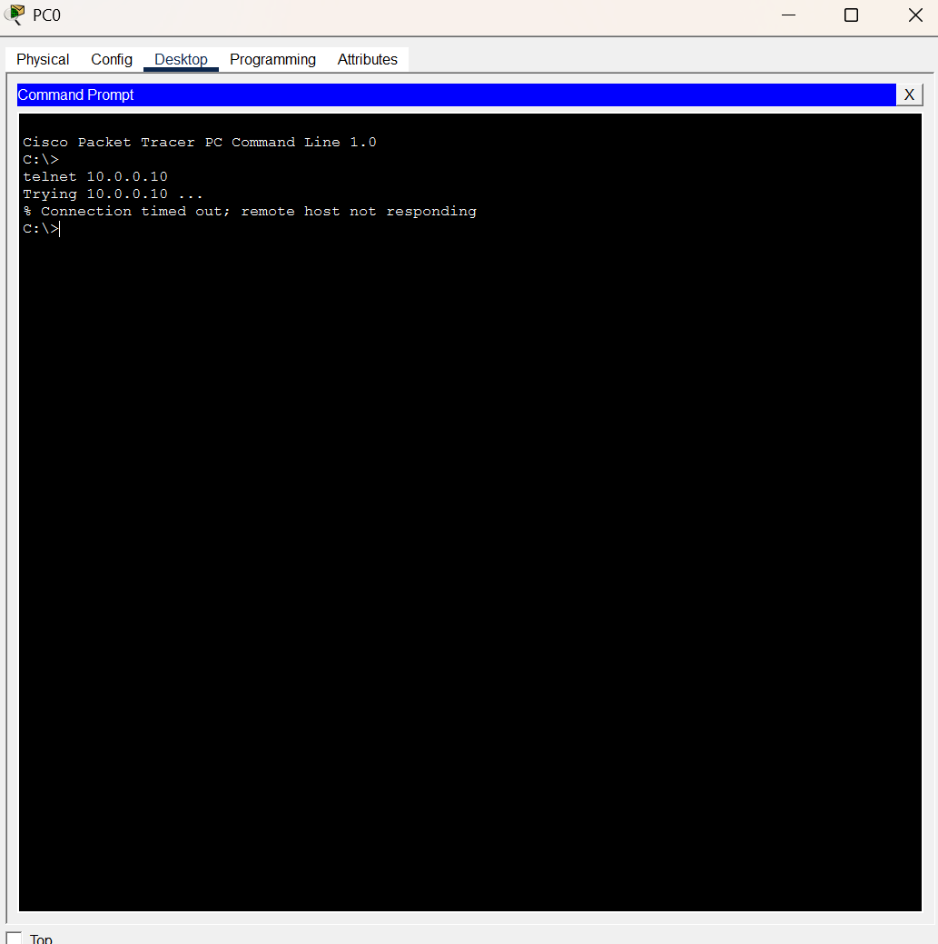
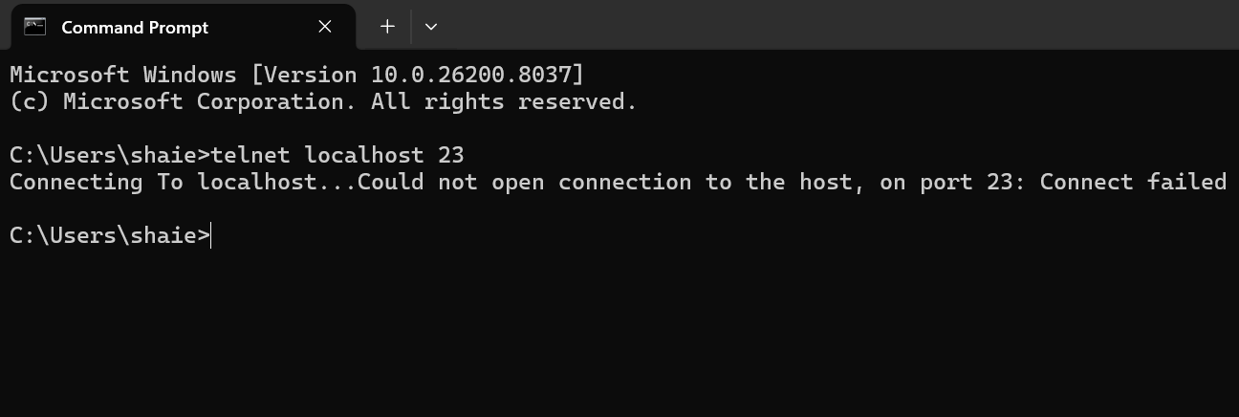
Blocked Traffic Testing
✗ Telnet Blocked by Firewall ACL
Telnet Blocked by Firewall ACL

Slide 12
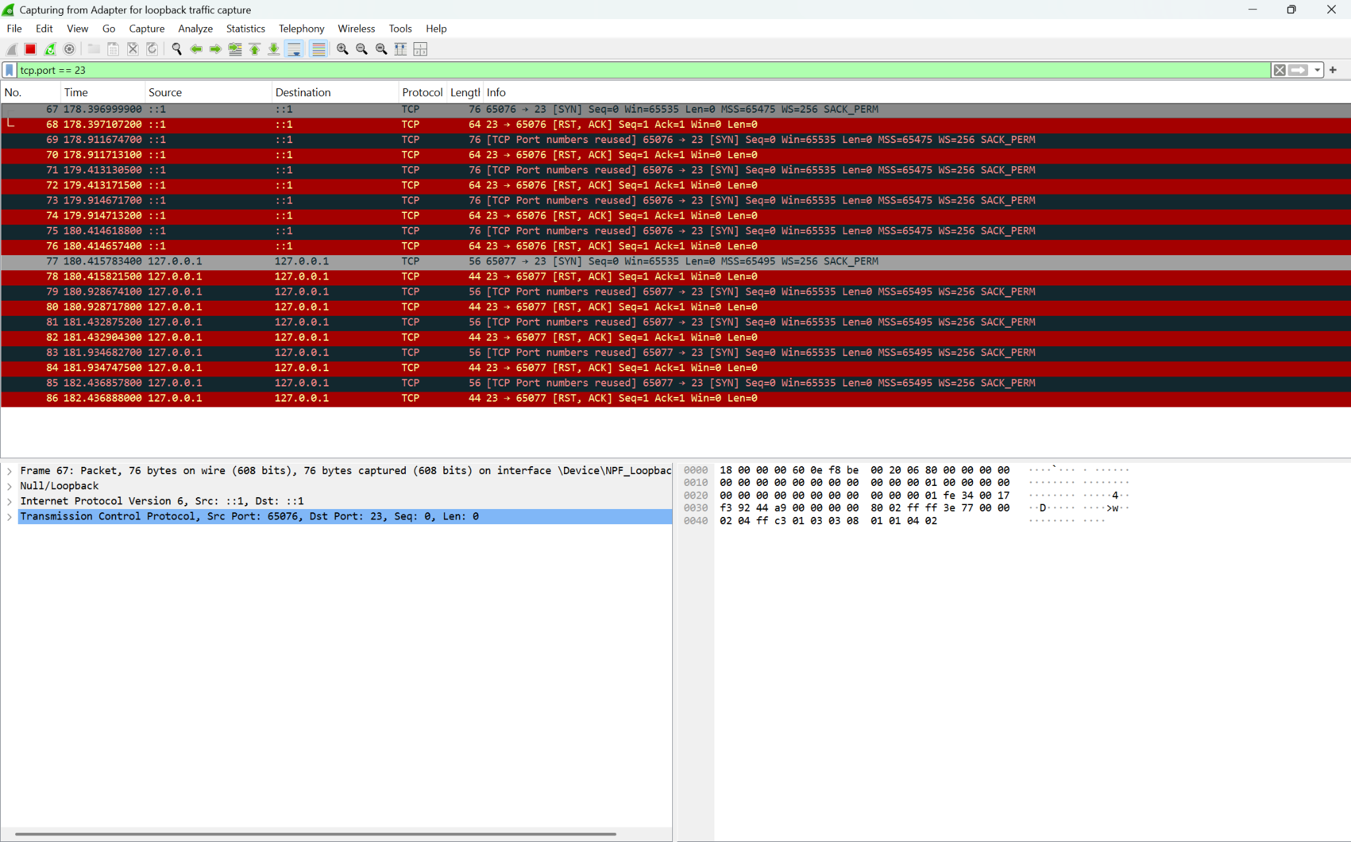
Wireshark - Blocked Telnet Traffic (Port 23 Denied)
Wireshark captured TCP traffic on port 23 showing SYN packets attempting a Telnet connection immediately followed by RST/ACK reset packets, confirming the connection was refused and blocked. No successful connection was established on port 23.

Slide 13
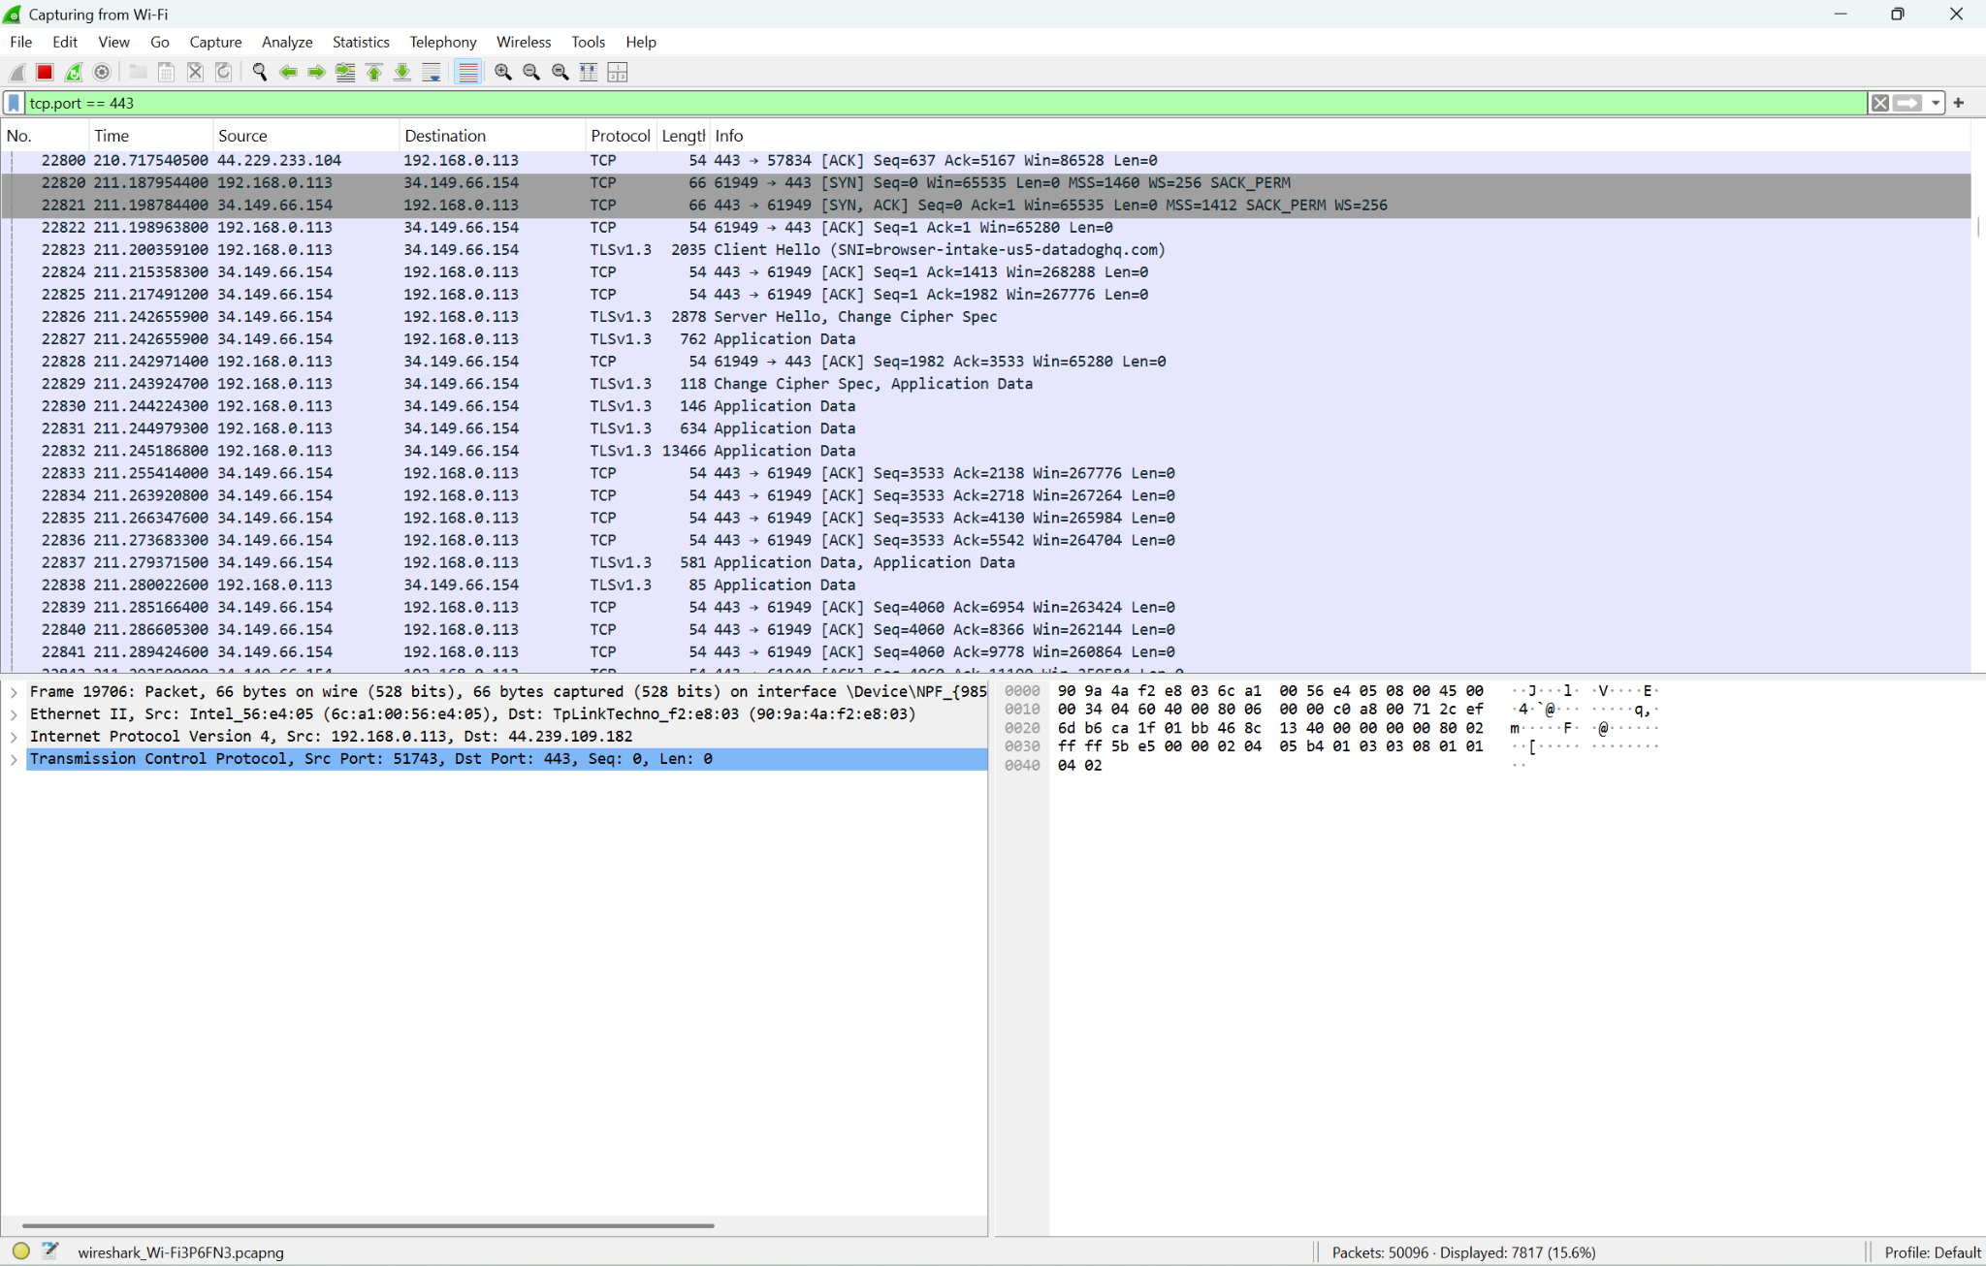
Wireshark - Successful HTTPS Connection (Port 443 Allowed)
Wireshark captured live HTTPS traffic on TCP port 443 using the Wi-Fi adapter. The capture shows a complete TCP three-way handshake (SYN, SYN-ACK, ACK) followed by TLSv1.3 encrypted data exchange between the host machine (192.168.0.113) and an external server (34.149.66.154). This confirms that port 443 traffic flows freely through the network, consistent with the FIREWALL_POLICY ACL rule permitting all TCP traffic on port 443.

Slide 14
Issues & Troubleshooting
Applied ACL to the wrong interface first, The ACL was initially applied to Fa0/0 instead of Fa0/1, causing the server to become unreachable. Fixed by moving the ip access-group FIREWALL_POLICY inbound command to Fa0/1.
FastEthernet1/0 Did Not Exist The 2811 router only has Fa0/0 and Fa0/1. Configuring Fa1/0 returned an "Invalid interface" error. Fixed by reassigning the server connection to Fa0/0.
Packet Tracer File Lost After Restart The topology file was not saved before restarting to install Telnet Client. The entire topology and ACL configuration had to be rebuilt from scratch.
VPN Interference with Wireshark Capture ProtonVPN was running during Wireshark captures, encrypting all Wi-Fi traffic and preventing port 80 and 443 packets from being visible. Resolved by switching to the loopback adapter to capture local Telnet traffic instead.

Slide 15
Lab 3 Successfully Completed
✓ Firewall interfaces configured — Fa0/0 and Fa0/1 (both up/up
✓ FIREWALL_POLICY applied inbound on FastEthernet0/1 — all 5 rules active
✓ HTTP (port 80) and HTTPS (port 443) permitted — Server0 web page loaded successfully
✓ Telnet (port 23) blocked — Wireshark and show access-list confirmed enforcement

